Slide 1
FortiGate Security
Firewall Policies
FortiOS 7.2
Notes:
In this lesson, you will learn about firewall policies and how to apply them to allow and deny traffic passing through FortiGate. At its core, FortiGate is a firewall, so almost everything that it does to your traffic is linked to your firewall policies.

Slide 2
Firewall Policies
Configuring Firewall Policies
Managing Firewall Policies
Best Practices and Troubleshooting
Notes:
In this lesson, you will learn about the topics shown on this slide.

Slide 3
Firewall Policies
Identify components of firewall policies
Identify how FortiGate matches traffic to firewall policies
Notes:
After completing this section, you should be able to achieve the objectives shown on this slide.
By demonstrating competence in identifying the different components of firewall policies, and recognizing how FortiGate matches traffic with firewall policies and takes appropriate action, you will have a better understanding of how firewall policies interact with network traffic.

Slide 4
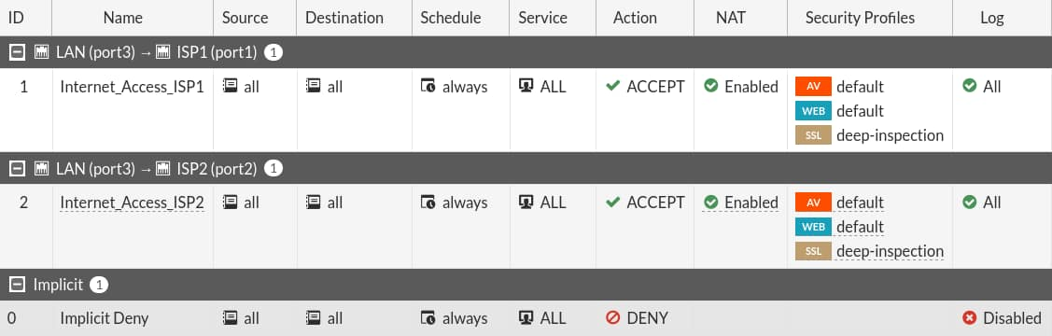
What Are Firewall Policies?
Policies define:
  Which traffic matches them
  How to process matching traffic
When a new IP session packet arrives, FortiGate:
  Starts at the top of the list to look for a policy match
  Applies the first matching policy
Implicit Deny
  No matching policy?
  FortiGate drops packet
Policy & Objects > Firewall Policy
Implicit Deny
Notes:
To begin, you will learn what firewall policies are.
Any traffic passing through a FortiGate must be associated with a firewall policy. A policy is a set of instructions that controls traffic flow through the FortiGate. These instructions determine where the traffic goes, how it's handled, and whether it's allowed to pass through the FortiGate. In summary, firewall policies are sets of rules that specify which traffic is allowed through the FortiGate and what FortiGate should do when traffic matches a policy.
Should the traffic be allowed? FortiGate bases this decision on simple criteria. FortiGate analyzes the source of the traffic, the destination IP address, and the service. If the policy does not block the traffic, FortiGate begins a more computationally expensive security profile inspection—often known as Unified Threat Management (UTM)—such as antivirus, application control, and web filtering, if you’ve chosen it in the policy. These inspections block the traffic if there is a security risk, for example, if the traffic contains a virus. Otherwise, the traffic is allowed.
Will network address translation (NAT) be applied? Is authentication required? Firewall policies also determine the answers to these questions. After processing is finished, FortiGate forwards the packet toward its destination.
FortiGate looks for the matching firewall policy from top to bottom and, if a match is found, the traffic is processed based on the firewall policy. If no match is found, the traffic is dropped by the default Implicit Deny firewall policy.

Slide 5
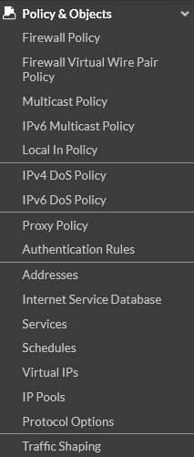
Components and Policy Types
Objects used by policies
Interface and zone
Address, user, and internet service objects
Service definitions
Schedules
NAT rules
Security profiles
Policy types
Firewall Policy (IPv4, IPv6)
Firewall Virtual Wire Pair Policy (IPv4, IPv6)
Proxy Policy
Multicast Policy
Local-in Policy
DoS Policy (IPv4, IPv6)
Traffic Shaping
Notes:
Each policy matches traffic and applies security by referring to the objects that you’ve defined, such as addresses and profiles.
Common policy types are:
Firewall Policy: A firewall policy consists of set of rules that control traffic flow through FortiGate.
Firewall Virtual Wire Pair Policy: A virtual wire pair policy is used to control the traffic between the interfaces in a virtual wire pair.
Multicast Policy: A multicast policy allows multicast packets to pass from one interface to another.
Local In Policy: A local-in policy controls the traffic to a FortiGate interface and can be used to restrict administrative access.
DoS Policy: A denial-of-service (DoS) policy checks for the anomalous patterns in the network traffic that arrives at a FortiGate interface.
By default, only Firewall Policy is visible under Policy and Object. Other policies are available based on the interface configurations and advanced features enabled through Feature Visibility.
In this lesson, you will learn about IPv4 firewall policies, because they are the most commonly used policies.

Slide 6
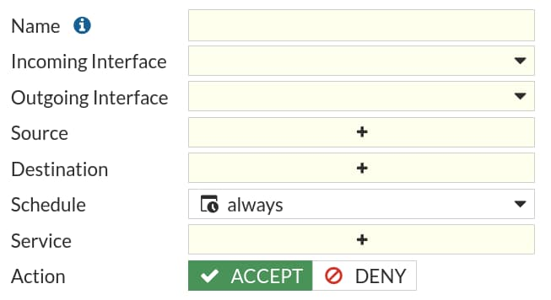


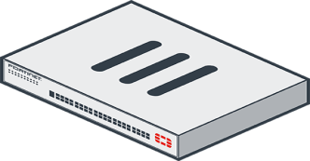


How Are Policy Matches Determined?
Incoming and outgoing interfaces
Policy & Objects > Firewall Policy
Source: IP address, user, internet services
Destination: IP address or internet services
Services
Schedules
Action = ACCEPT or DENY
Authentication
Logging
Security Profile
Notes:
When a packet arrives, how does FortiGate find a matching policy? Each policy has match criteria, which you can define using the following objects:
Incoming Interface
Outgoing Interface
Source: IP address, user, internet services
Destination: IP address or internet services
Service: IP protocol and port number
Schedule: Specific times to apply policy
If the traffic matches a firewall policy, FortiGate applies the action configured in the firewall policy:
If the Action is set to DENY, FortiGate drops the session.
If the Action is set to ACCEPT, FortiGate allows the session and applies other configured settings for packet processing, such as user authentication, source NAT, antivirus scanning, web filtering, and so on.
When FortiGate receives traffic, it evaluates the packet’s source IP address, destination IP address, and the requested service (protocol and port number). It also checks the incoming interface and the outgoing interface it needs to use. Based on this information, FortiGate identifies the firewall policy and evaluates the traffic. If the traffic matches the policy, then FortiGate applies the action (Accept/Deny) defined in the policy.
For example, to block incoming FTP traffic to all but a few FTP servers, define the addresses of the FTP servers as the destination, and select FTP as the service. You probably wouldn’t specify a source (often any location on the internet is allowed) or schedule (FTP servers are usually always available, day or night). Finally, set the Action setting to ACCEPT.

Slide 7
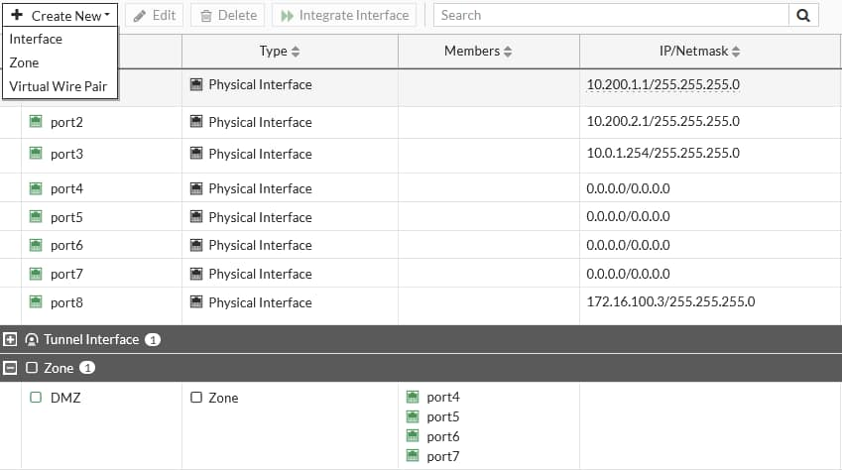
Simplify—Interfaces and Zones
The incoming and outgoing interfaces can function as individual interfaces or you can create a zone, which is a logical group of interfaces
To match policies with traffic, select one or more interfaces
Network > Interfaces
Incoming
Outgoing
Zone
Notes:
To begin describing how FortiGate finds a policy for each packet, let’s start with the interfaces.
Packets arrive on an incoming, or ingress, interface. Routing determines the outgoing, or egress, interface. In each policy, you must set a source and destination interface; even if one or both are set to any. Both interfaces must match the policy’s interface criteria in order to be a successful match.
For example, if you configure policies between port3 (LAN) ingress and port1 (WAN) egress and a packet arrives on port2, the packet will not match your policies and, therefore, would be dropped because of the implicit deny policy at the end of the list. Even if the policy is from port3 (LAN) ingress to any egress, the packet would still be dropped because it did not match the incoming interface.
To simplify policy configuration, you can group interfaces into logical zones. For example, you could group port4 to port7 as a DMZ. You can create zones on the Interfaces page. However, you should note that you cannot reference an interface in a zone individually, and, if you need to add the interface to the zone, you must remove all references to that interface (for example, firewall policies, firewall addresses, and so on). If you think you might need to reference interfaces individually, you should set multiple source and destination interfaces in the firewall policy, instead of using zones.

Slide 8

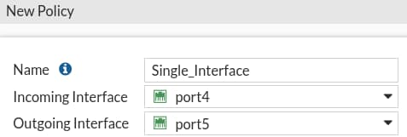
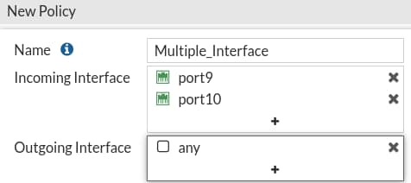
Selecting Multiple Interfaces or Any Interface
Disabled by default
  Cannot select multiple interfaces or any interface in firewall policy on the GUI
Can be made visible in the GUI
System > Feature Visibility
Policy & Objects > Firewall Policy
Policy & Objects > Firewall Policy
Multiple interface policies enabled
Multiple interface policies disabled
Notes:
By default, you can select only a single interface as the incoming interface and a single interface as the outgoing interface. This is because the option to select multiple interfaces, or any interface in a firewall policy, is disabled on the GUI. However, you can enable the Multiple Interface Policies option on the Feature Visibility page to disable the single interface restriction.
You can also specify multiple interfaces, or use the any option, if you configure a firewall policy on the CLI, regardless of the default GUI setting.
It is also worth mentioning that when you choose the any interface option, you cannot select multiple interfaces for that interface. In the example shown on this slide, because any is selected as the outgoing interface, you cannot add any additional interfaces, because any interface implies that all interfaces have already been selected.

Slide 9
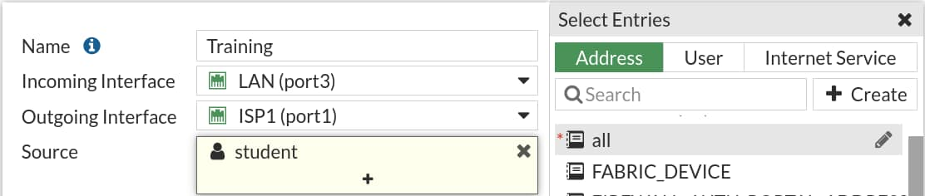
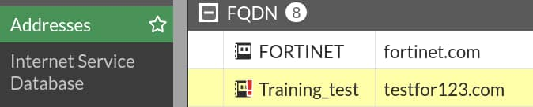
Matching by Source
Must specify at least one source (address or internet service database (ISDB) object)
  IP address or range
  Subnet (IP/netmask)
  FQDN
  Geography
  Dynamic
    Fabric connector address
  MAC Address Range
May specify:
  Source user—individual user or user group
  This may refer to:
    Local firewall accounts
    Accounts on a remote server (for example, Active Directory, LDAP, RADIUS)
    FSSO
    Personal certificate (PKI-authenticated) users
Optional
Policy & Objects > Firewall Policy
Mandatory source address field
Warning for unresolved FQDN
Notes:
The next match criteria that FortiGate considers is the packet’s source.
In each firewall policy, you must select a source address object. Optionally, you can refine your definition of the source address by also selecting a user, or a user group, which provides a much more granular match, for increased security. You can also select ISDB objects as the source in the firewall policy, which you will learn about later in this lesson.
When selecting a fully qualified domain name (FQDN) as the source address, it must be resolved by DNS and cached in FortiGate. Make sure FortiGate is configured properly for DNS settings. If FortiGate is not able to resolve an FQDN address, it will present a warning message, and a firewall policy configured with that FQDN may not function properly.

Slide 10

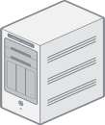


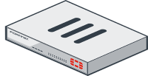

Source—User Identification
Confirms identity of user
Access to network is provided after confirming user credentials
3
1
Verify username and password
Local user
2
Username and password
Verified
4
Authentication Server
1
2
Username and password
Remote user
Notes:
If a user is added as part of the source, FortiGate must verify the user before allowing or denying access based on the firewall policy. There are different ways that a user can authenticate.
For local users, the username and password is configured locally on FortiGate. When a local user authenticates, the credentials that they enter must match the username and password configured locally on FortiGate.
For a remote user (for example, LDAP or RADIUS), FortiGate receives the username and password from the remote user and passes this information to the authentication server. The authentication server verifies the user login credentials and updates FortiGate. After FortiGate receives that information, it grants access to the network based on the firewall policy.
A Fortinet single sign-on (FSSO) user's information is retrieved from the domain controller. Access is granted based on the group information on FortiGate.

Slide 11
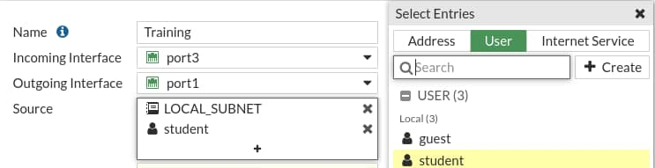
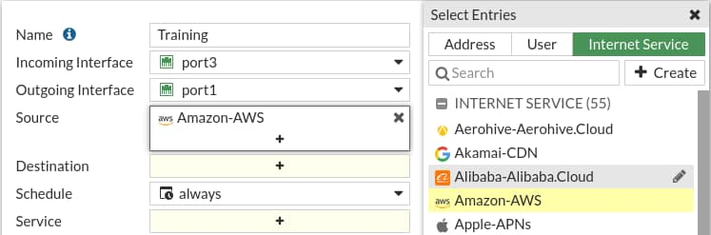
Example—Matching Policy by Source
Source as internet service database (ISDB) objects
Matches by source address, user
Policy & Objects > Firewall Policy
Policy & Objects > Firewall Policy
Address
User
Internet Service
Notes:
In the example shown on this slide, source selectors identify the specific subnet and user group.
Remember, user is an optional object. The user object is used here to make the policy more specific. If you wanted the policy to match more traffic, you would leave the user object undefined.
You can also use internet service (ISDB) objects as a source in the firewall policy. There is an either/or relationship between internet service objects and source address objects in firewall policies. This means that you can select either a source address or an internet service, but not both.

Slide 12
Matching by Destination
Like source, destination criteria can use:
Address objects:
  Subnet (IP or netmask)
  IP address or address range
  FQDN
    DNS query used to resolve FQDN
  Geography
    Country defines addresses by ISP’s geographical location
    Database updated periodically through FortiGuard
  Dynamic
    Fabric connector address
Internet service database (ISDB) objects
Notes:
Like the packet’s source, FortiGate also checks the destination address for a match.
You can use address objects or ISDB objects as destinations in the firewall policy. The address object may be a host name, IP subnet, or range. If you enter an FQDN as the address object, make sure that you’ve configured your FortiGate device with DNS servers. FortiGate uses DNS to resolve those FQDN host names to IP addresses, that appear in the IP header.
You can also choose geographic addresses, which are groups or ranges of addresses that are assigned to a country. FortiGuard is used to update these objects.
Why is there is no option to select a user? The user identification is determined at the ingress interface, and packets are forwarded only to the egress interface after the user is successfully authenticated.

Slide 13
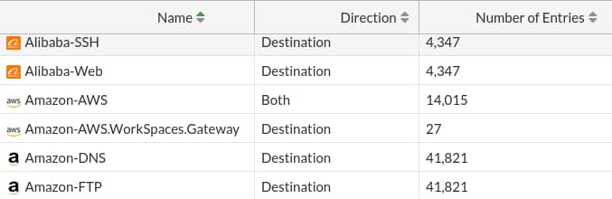
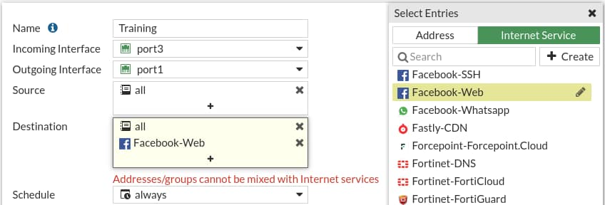
Internet Service
Database that contains IP addresses, IP protocols, and port numbers used by the most common internet services
  Regularly updated through FortiGuard
Can be used as Source or Destination in the firewall policy
If Internet Service is selected as Source:
  You cannot use Address in the Source
If Internet Service is selected as Destination:
  You cannot use Address in the Destination
  You cannot select Service in the firewall policy
Policy & Objects > Internet Service Database
Policy & Objects > Firewall Policy
Notes:
Internet Service is a database that contains a list of IP addresses, IP protocols, and port numbers used by the most common internet services. FortiGate periodically downloads the newest version of this database from FortiGuard. You can select these as Source or Destination in the firewall policy.
What happens if you need to allow traffic to only a few well-known public internet destinations, such as Dropbox or Facebook?
When configuring your firewall policy, you can use Internet Service as the destination in a firewall policy, which contains all the IP addresses, ports, and protocols used by that service. For the same reason, you cannot mix regular address objects with ISDB objects, and you cannot select services on a firewall policy. The ISDB objects already have services information, which is hardcoded.
Compared with address objects, which you need to check frequently to make sure that none of the IP addresses have changed or appropriate ports are allowed, internet services helps make this type of deployment easier and simpler.

Slide 14
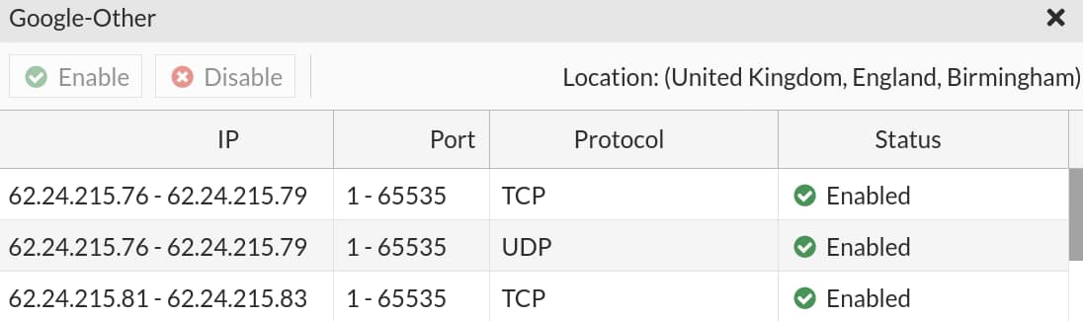

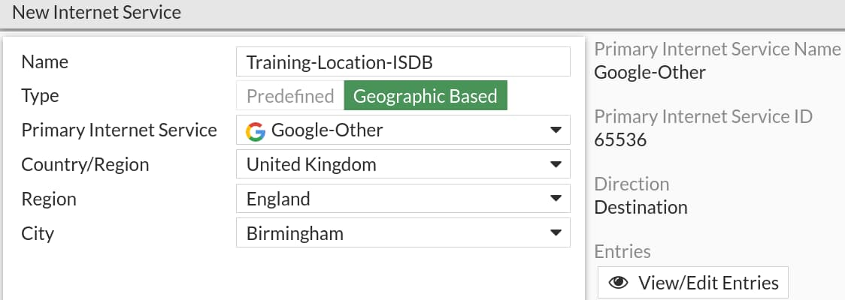
Geographic-Based Internet Service Database
Allows users to define ISDB objects based on a country, region, and city
Objects can be used in firewall policies for more granular control over the location of the parent ISDB object
Policy & Objects > Internet Service Database
Notes:
Geographic-based ISDB objects allow users to define a country, region, and city. These objects can be used in firewall policies for more granular control over the location of the parent ISDB object.
ISDB objects are referenced in policies by name, instead of by ID.

Slide 15
Internet Service Database (ISDB)—Updates
You can disable ISDB updates so they occur only during a change control window
  Control ISDB updates by using CLI command:
Once ISDB updates are disabled, other scheduled FortiGuard updates do not update ISDB
By default, ISDB updates are enabled
# config system fortiguard
set update-ffdb [enable | disable]
next
end
Notes:
You can disable ISDB updates, so they occur only during a change control window. Once ISDB updates are disabled, other scheduled FortiGuard updates for IPS, AV, and so on, do not update ISDB. By default, ISDB updates are enabled.

Slide 16

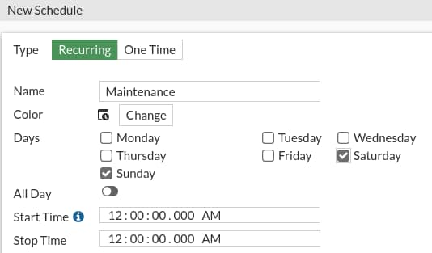
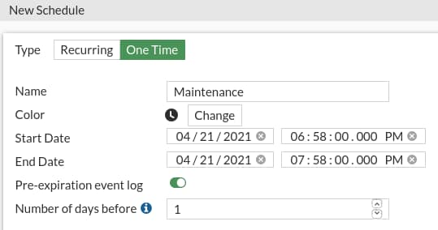
Scheduling
Policies apply only during specific times and on specific days
  Example: A less restrictive lunch time policy
  The default schedule applies all the time
Recurring
    Happens at the same time during specified day(s)
    of the week
One-time
  Happens only once
Policy & Objects > Schedules
Policy & Objects > Schedules
Notes:
Schedules add a time element to the policy. For example, you might use a policy to allow backup software to activate at night, or create a test window for a remote address that is allowed for testing purposes.
Schedules can be configured and use a 24-hour time clock. There are a few configuration settings worth mentioning:
Recurring: If you enable All Day, traffic will be allowed for 24 hours for the days selected. When configuring recurring schedules, if you set the stop time earlier than the start time, the stop time will occur the next day. For example, if you select Sunday as the day, 10:00 as the start time, and 09:00 as the stop time, the schedule will stop on Monday at 09:00. If the start and stop time are identical, the schedule will run for 24 hours.
One-time: The start date and time must be earlier than the stop date and time. You can also enable Pre-expiration event log, which will generate an event log N number of days before the schedule expires, where N can be from 1 to 100 days.

Slide 17
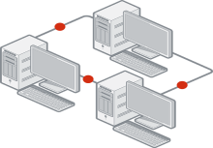


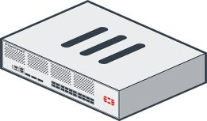
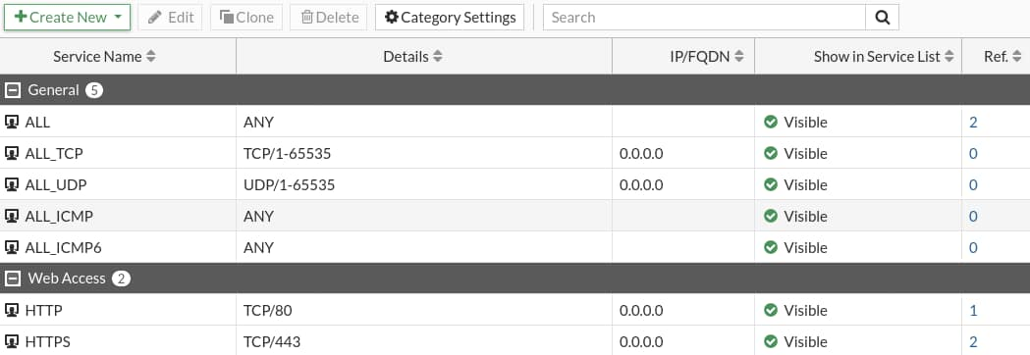
Matching by Service
Service determines matching transmission protocol (UDP, TCP, and so on) and port number
Can be predefined or custom
ALL matches all ports and protocols
Packet
=
Firewall Policy
Policy & Objects > Services
Protocol and Port
Protocol and Port
Notes:
Another criterion that FortiGate uses to match policies is the packet’s service.
At the IP layer, protocol numbers (for example, TCP, UDP, SCTP, and so on) together with source and destination ports, define each network service. Generally, only a destination port (that is, the server’s listening port) is defined. Some legacy applications may use a specific source port, but in most modern applications, the source port is randomly identified at transmission time, and therefore is not a reliable way to define the service.
For example, the predefined service object named HTTP is TCP destination port 80, and the predefined service object named HTTPS is TCP destination port 443. However, the source ports last for only a short time and, therefore, are not defined.
By default, services are grouped together to simplify administration by categories. If the predefined services don’t meet your organizational needs, you can create one or more new services, service groups, and categories.

Slide 18

What criteria does FortiGate use to match traffic to a firewall policy?
  Source and destination interfaces
  Security profiles
What must be selected in the Source field of a firewall policy?
  At least one address object or ISDB
  At least one source user and one source address object

Slide 19
Firewall Policies
Configuring Firewall Policies
Managing Firewall Policies
Best Practices and Troubleshooting
Notes:
Good job! You now understand the components used in firewall policies and matching criteria used by FortiGate.
Now, you’ll learn how to configure firewall policies.

Slide 20
Configuring Firewall Policies
Restrict access and make your network more secure using security profiles
Configure logging
Notes:
After completing this section, you should be able to achieve the objectives shown on this slide.
By demonstrating competence in configuring firewall policies, you will be able to apply the correct settings, such as security profiles, logging, and traffic shaping, to firewall policies on FortiGate, and make your network more secure.

Slide 21

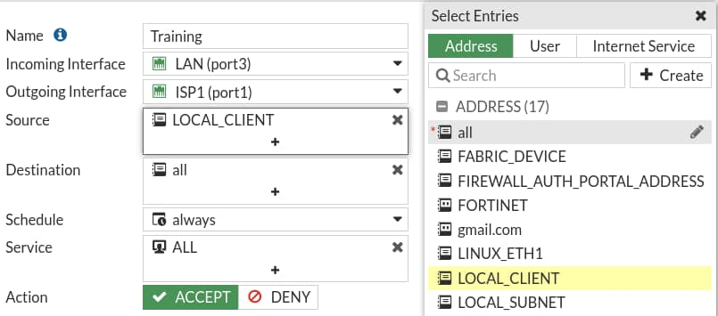
Configuring Firewall Policies
System > Feature Visibility
Mandatory policy name when creating on GUI
  Can relax the requirement by enabling Allow Unnamed Policies
Flat GUI view allows:
  Select by clicking
  Drag-and-drop
Enabled by default
MUST specify unique name
Highlights selected entry
config firewall policy
edit 1
set name “Training"
set uuid 2204966e-47f7-51..
Universally unique identified (UUID)
Notes:
When you configure a new firewall policy on the GUI, you must specify a unique name for the firewall policy because it is enabled by default, while it is optional on the CLI. This helps the administrator to quickly identify the policy that they are looking for. However, you can make this feature optional on the GUI on the Feature Visibility page by enabling Allow Unnamed Policies.
Note that if a policy is configured without a policy name on the CLI, and you modify that existing policy on the GUI, you must specify a unique name. The FortiGate flat GUI view allows you to select interfaces and other objects by clicking or dragging and dropping from the list populated on the right side.
You can select Internet Service as the source. Internet Service is a combination of one or more addresses and one or more services associated with a service found on the internet, such as an update service for software.
There are many other options that you can configure in the firewall policy, such as firewall and network options, security profiles, logging options, and enabling or disabling a policy.
When creating firewall objects or policies, a universally unique identifier (UUID) attribute is added so that logs can record these UUIDs and improve functionality when integrating with FortiManager or FortiAnalyzer.
When creating firewall policies, remember that FortiGate is a stateful firewall. As a result, you need to create only one firewall policy that matches the direction of the traffic that initiates the session. FortiGate will automatically remember the source-destination pair and allow replies.

Slide 22
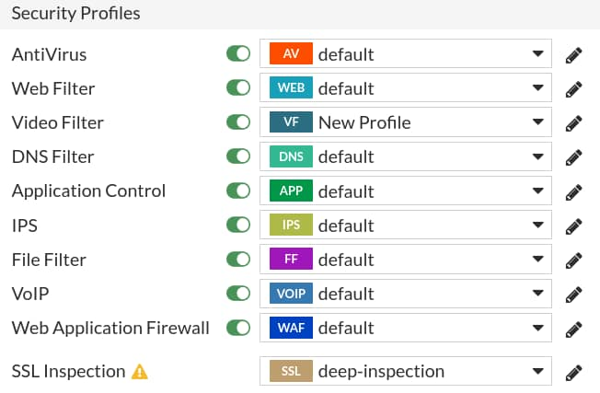
Security Profiles
Firewall policies limit access to configured networks
Security profiles configured in firewall policies protect your network by:
  Blocking threats
  Controlling access to certain applications and URLs
  Preventing specific data from leaving your network
Policy & Objects > Firewall Policy
Default profile not available, you need to manually create a profile
Notes:
One of the most important features that a firewall policy can apply is security profiles, such as IPS and antivirus. A security profile inspects each packet in the traffic flow, where the session has already been conditionally accepted by the firewall policy.
When inspecting traffic, FortiGate can use one of two methods: flow-based inspection or proxy-based inspection. Different security features are supported by each inspection type.
Note that by default, the Video Filter, VOIP, and Web Application Firewall security profile option is not visible in the policy page on the GUI. You need to enable them on the Feature Visibility page.

Slide 23
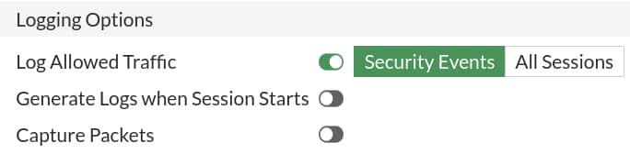

Logging
By default, set to Security Events
  Generates logs based on applied security profile only
Can change to All Sessions
Accept
Deny
config system setting
set ses-denied-traffic [disable | enable]
end
config system global
set block-session-timer [1-300]
end
Notes:
If you have enabled logging in the policy, FortiGate generates traffic logs after a firewall policy closes an IP session.
By default, Log Allowed Traffic is enabled and set to Security Events and generates logs for only the applied security profiles in the firewall policy. However, you can change the setting to All Sessions, which generates logs for all sessions.
If you enable Generate Logs when Session Starts, FortiGate creates a traffic log when the session begins. FortiGate also generates a second log for the same session when it is closed. But remember that increasing logging decreases performance, so use it only when necessary.
During the session, if a security profile detects a violation, FortiGate records the attack log immediately. To reduce the number of log messages generated and improve performance, you can enable a session table entry of dropped traffic. This creates the denied session in the session table and, if the session is denied, all packets of that session are also denied. This ensures that FortiGate does not have to do a policy lookup for each new packet matching the denied session, which reduces CPU usage and log generation.
This option is in the CLI, and is called ses-denied-traffic. You can also set the duration for block sessions. This determines how long a session will be kept in the session table by setting block-session-timer in the CLI. By default, it is set to 30 seconds.
If the GUI option Generate Logs when Session Starts is not displayed, this means that your FortiGate device does not have internal storage. This option is on the CLI, regardless of internal storage, and is called set logtraffic-start enable.

Slide 24

Traffic Shapers
Rate limiting is configurable
  In bandwidth and out bandwidth
  Defines maximum and guaranteed bandwidth
Policies & Objects > Traffic Shaping Policy
Shared Traffic Shaper
Per-IP Traffic Shaper
Guaranteed Bandwidth
Maximum Bandwidth
Guaranteed Bandwidth
Maximum Bandwidth
Guaranteed Bandwidth
Maximum Bandwidth
Guaranteed Bandwidth
Maximum Bandwidth
Notes:
You can configure two types of traffic shapers: shared and per IP.
A shared shaper applies a total bandwidth to all traffic using that shaper. The scope can be per policy or for all policies referencing that shaper. FortiGate can count the packet rates of ingress and egress to police traffic.
FortiGate allows you to create three types of traffic shaping policies:
Shared policy shaping: bandwidth management of security policies
Per-IP shaping: bandwidth management of user IP addresses
Application control shaping: bandwidth management by application
When creating traffic shaping policies, you must ensure that the matching criteria is the same as the firewall policies you want to apply shaping to. Note that these apply equally to TCP and UDP, and UDP protocols may not recover as gracefully from packet loss.

Slide 25
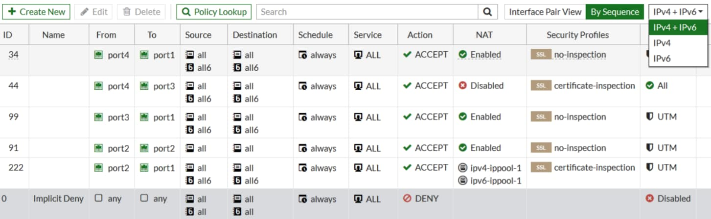
Consolidated IPv4 and IPv6 Policy Configuration
IPv4 and IPv6 policies are combined into a single consolidated policy, instead of separate policies
The IP version of the sources and destinations in a policy must match
Single policy table for GUI
Different IP addresses and IP pool for IPv4 and IPv6
Policy & Objects > Firewall Policy
Notes:
By default, IPv4 and IPv6 policies are combined into a single consolidated policy, rather than creating and maintaining two different policy sets for IPv4 and IPv6.
You can share the Incoming Interface, Outgoing Interface, Schedule, and Service fields with both IPv4 and IPv6. For source addresses, destination addresses, and IP pool, you must select addresses for both IPv4 and IPv6.
While configuring a consolidated firewall policy, you can configure a policy with IPv4 source addresses, IPv4 destination addresses, and an IPv4 IP pool, without specifying any IPv6 references. You can also configure the policy with the same behavior for IPv6. However, if you want to combine IPv4 and IPv6, you must select both IPv4 addresses and IPv6 addresses in the Source and Destination address fields in the firewall policy.The IP version of the sources and destinations in a policy must match. For example, a policy cannot have only an IPv4 source and an IPv6 destination. The policy table in the GUI can be filtered to show policies with IPv4, IPv6, or IPv4 and IPv6 sources and destinations.
Note that, by default, the IPv6 option is not visible in the policy table on the GUI. You must enable IPv6 on the Feature Visibility page.

Slide 26
To configure a firewall policy, you must include a firewall policy name when configuring using the _____.
  CLI
  GUI
What is the purpose of applying security profiles to a firewall policy?
  To allow access to specific subnets
  To protect your network from threats, and control access to specific applications and URLs

Slide 27
Firewall Policies
Configuring Firewall Policies
Managing Firewall Policies
Best Practices and Troubleshooting
Notes:
Good job! You now understand how to configure firewall policies on FortiGate.
Next, you’ll learn how to manage and fine-tune settings for firewall policies.

Slide 28
Managing Firewall Policies
Identify policy list views
Understand the use of policy IDs
Identify where an object is referenced
Notes:
After completing this section, you should be able to achieve the objectives shown on this slide.
By demonstrating competence in managing firewall policies, you will be able to understand the use of the policy ID of a firewall policy. Also, you will be able to pinpoint object usage, and simplify policies using object groups.

Slide 29
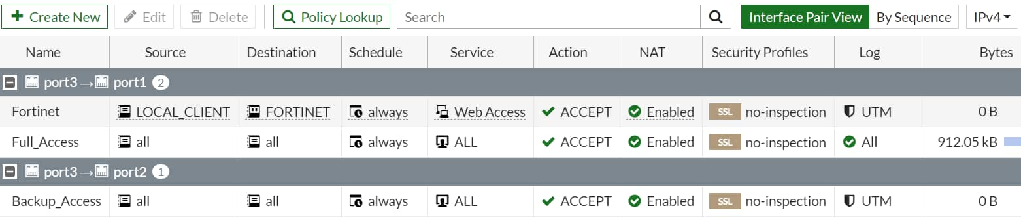
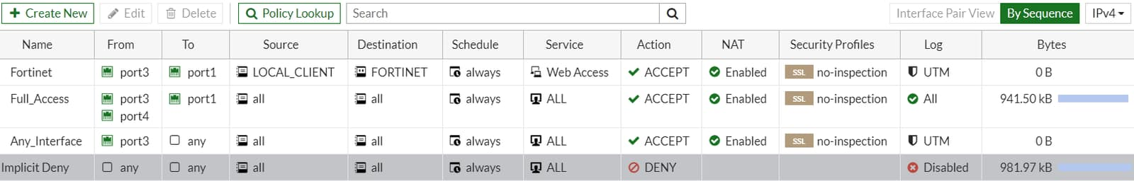
Policy List—Interface Pair View and By Sequence
Interface Pair View
  Lists policies by ingress and egress interfaces (or zone) pairings
By Sequence (only)
  If policies are created using multiple source and destination interfaces or any interface
Can view By Sequence also
Policy & Objects > Firewall Policy
Interface policy pairs
Interface policy pairs
Policy & Objects > Firewall Policy
Multiple interfaces
any interface
Notes:
Firewall policies appear in an organized list. The list is organized either in Interface Pair View or By Sequence.
By default, the policy list appears in Interface Pair View. Each section contains policies in the order that they are evaluated for matching traffic and are arranged by ingress-egress interface pair. Alternatively, you can view your policies as a single, comprehensive list by selecting By Sequence at the top of the page. In this view the policies are also listed in the order in which they are evaluated for traffic matching, but they are not grouped.
In some cases, you cannot choose the view. For example, if you use multiple source or destination interfaces, or the any interface in a firewall policy, you cannot separate policies into sections by interface pairs—some would be triplets or more. In this case, policies always appear in a single list (By Sequence).
To help you remember the use of each interface, you add aliases by editing the interface on the Network page. For example, you could call port1 ISP1. This can help to make your list of policies easier to understand.

Slide 30
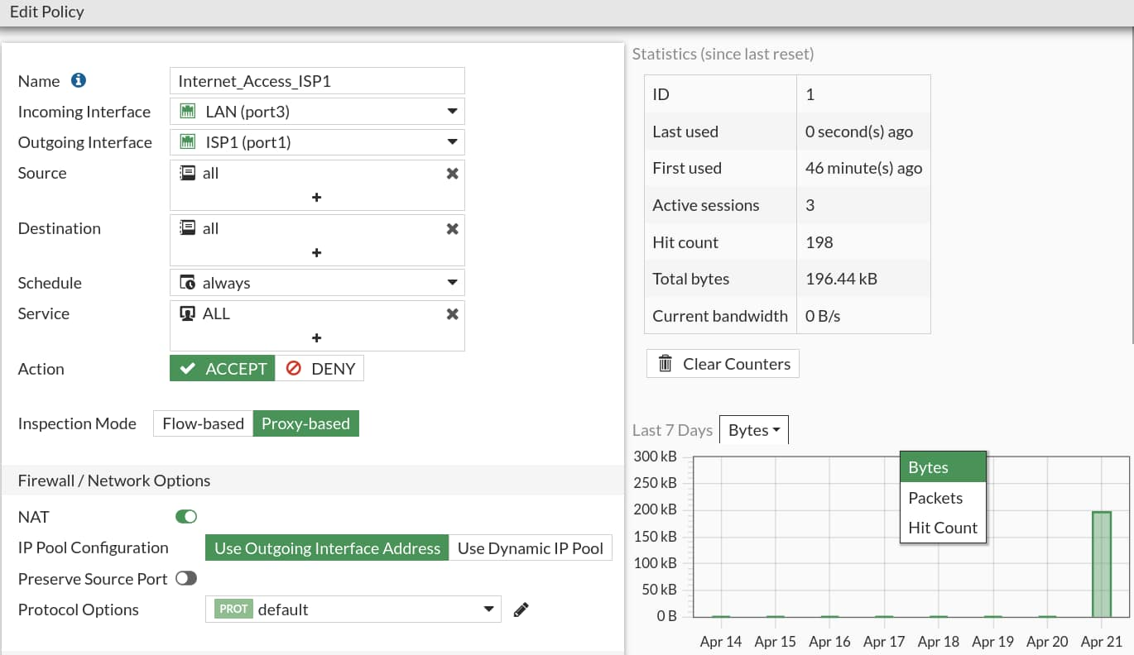
Real-Time Policy Status
Real-time policy status update
  ID
  Last used
  First used
  Active sessions
  Hit count
  Total bytes
  Current bandwidth
  Usage graph
Policy & Objects > Firewall Policy
Reset Counters
Graph options
Notes:
When you edit the policy, policy information will be visible.
This feature is very useful if an administrator wanted to check the policy usage, such as last used, first used, hit count, active sessions, and so on.

Slide 31
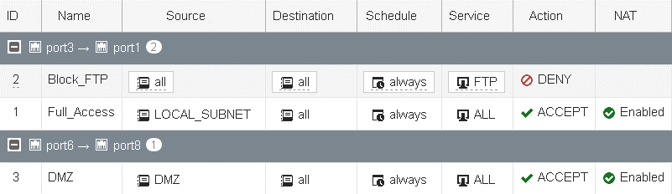
Policy ID
Firewall policies are primarily ordered on a top-down basis
Policy IDs are identifiers:
  The policy ID is assigned by the system when the rule is created
  The ID number never changes as rules move higher or lower in the sequence
  Policy IDs are not displayed by default on the GUI
config firewall policy
edit <policy_id>
end
Policy ID
Policy ID
Policy & Objects > Firewall Policy
config firewall policy
edit 2
set name " Block_FTP"
...
next
edit 1
set name “Full_Access"
Notes:
An important concept to understand about how firewall policies work is the precedence of order, or, if you prefer a more recognizable term, first come, first served.
Policy IDs are identifiers. By default, policy IDs are not displayed on the policy list GUI. You can add a policy ID column using the Configure Table settings icon.
FortiGate automatically assigns a policy ID when you create a new firewall policy on the GUI. The policy ID never changes, even if you move the rule higher or lower in the sequence.
If you enable Policy Advanced Options, then you can manually assign a policy ID, while creating a new policy. If a duplicate entry is found, the system produces an error, so you can assign a different available policy ID number.
Policy Advanced Options is not available on the GUI by default, you must enable it on the Feature Visibility page.

Slide 32
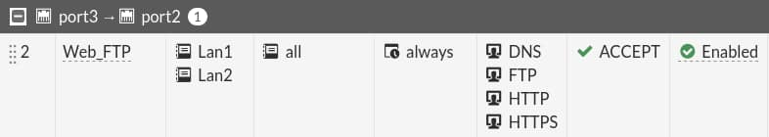
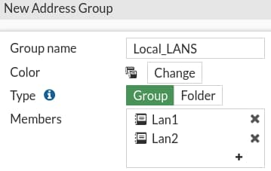
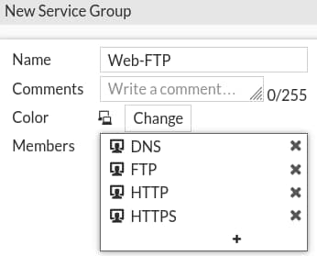
Simplify—Groups of Addresses or Services
You can reference address and service objects individually, or use groups to simplify policy configuration
Policy & Objects > Firewall Policy
Notes:
To simplify administration, you can group service and address objects. Then, you can reference that group in the firewall policy, instead of selecting multiple objects each time, or making multiple policies.
This slide shows that four services are used to configure the policy: HTTP, HTTPS, FTP, and DNS. DNS is used by browsers to resolve URLs to IP addresses because people remember domain names for websites instead of IP addresses. If you need to make many policies for web and FTP traffic, then it makes sense to create a service object named Web-FTP. That way, you don’t have to manually select all four services each time you make a policy. Policies can reference the Web-FTP service group instead.
Also, you can consolidate source addresses in source groups.

Slide 33
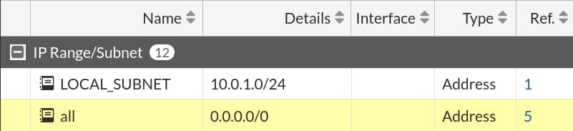
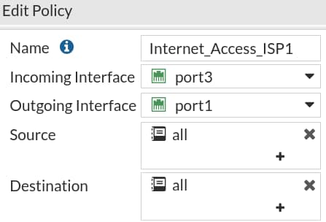
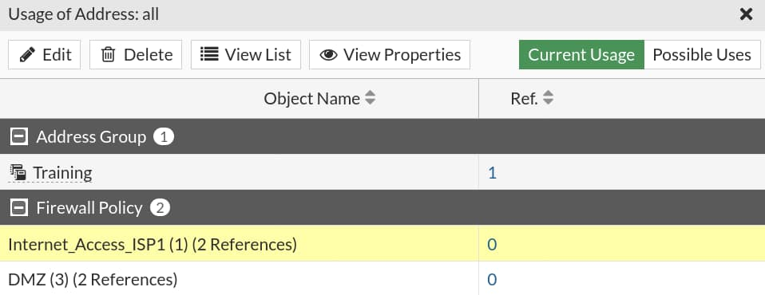
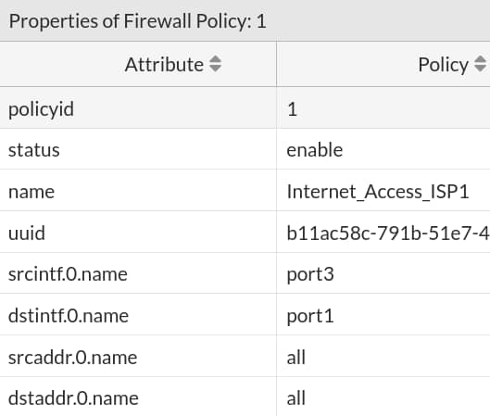
Object Usage
Allows for faster changes to settings
Reference column shows if the object is being used
  Links directly to the referencing object
Policy & Objects > Addresses
Number of times object used
Reference of group
Referenced by policy ID
Notes:
You've just seen several component objects that can be reused as you make policies. What if you want to delete an object?
If an object is being used, you can’t delete it. First, you must reconfigure the objects that are currently using it. The GUI provides a simple way to find out where in the FortiGate’s configuration an object is being referenced. Take a look at the numbers in the Ref column. They are the number of places where that object is being used. The number is actually a link, so if you click it, you can see which objects are using it.
In the example shown on this slide, the all address object is being used by the Training address group and three firewall policies. If you select a firewall policy, you can use the Edit, View List, and View Properties tabs.
Edit: allows you to edit the selected object. In this example, it shows the edit page for the firewall policy ID 1.
View List: allows you to view selected objects in its category. In this example, it will show you the list of all the firewall policies.
View Properties: shows where the object is used in that configuration. In this example, address object all is being used in the destination address and source address of that firewall policy.

Slide 34
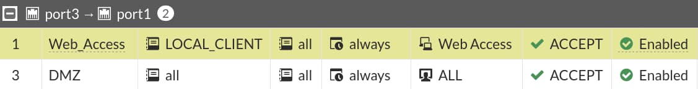
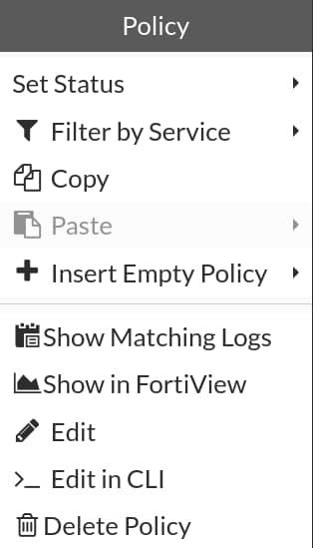
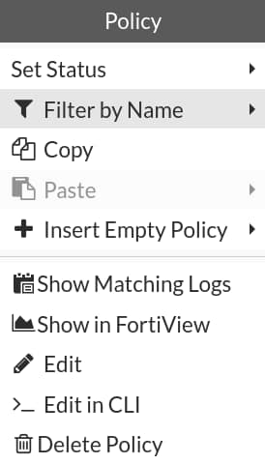
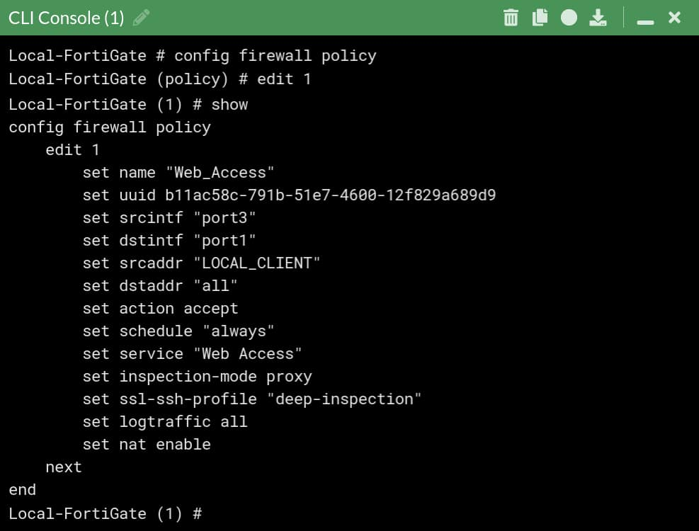
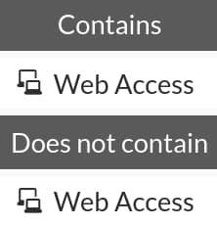
Firewall Policy—Fine Tuning
Right-click menu contains various options to add and modify policies
Policy & Objects > Firewall Policy
Notes:
You can right-click any firewall policy to see different menu options to edit or modify the policy. The options include enabling or disabling a firewall policy, inserting firewall policies (above or below), copying and pasting policies, and cloning reverse (only if NAT is disabled on that policy).
Clicking Edit in CLI opens the CLI console for the selected firewall policy or object. It shows the configured settings on the CLI and can modify the selected firewall policy or object directly on the CLI Console.

Slide 35
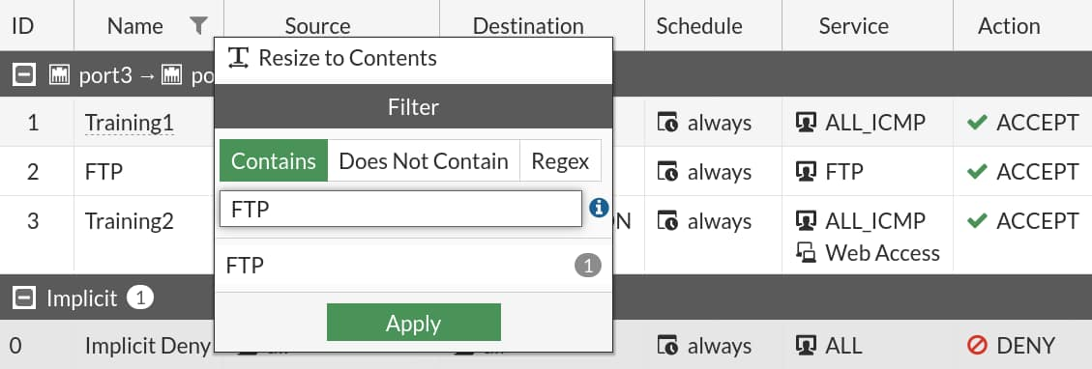
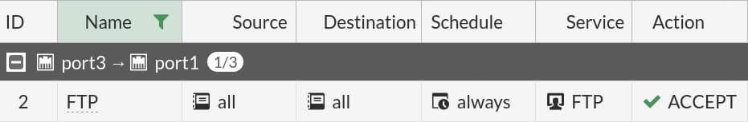
Filter Column
You can use filters in each column to filter firewall policies
Policy & Objects > Firewall Policy
Notes:
You can filter firewall policies on the GUI using filters in each column. You can add the ID column and then click the ID column filter icon to filter and search policies based on policy id numbers. You can click the Name filter icon to search policies based on policy name, and so on.

Slide 36
If you configure a firewall policy with the any interface, you can view the firewall policy list only in which view?_____ .
  The By Sequence View
  The Interface Pair View

Slide 37
Firewall Policies
Configuring Firewall Policies
Managing Firewall Policies
Best Practices and Troubleshooting
Notes:
Good job! You now understand how to manage firewall policies on FortiGate.
Now, you’ll learn about best practices and troubleshooting related to firewall policies.

Slide 38
Best Practices and Troubleshooting
Identify naming restrictions for firewall policies and objects
Reorder firewall policies for correct matching
Demonstrate how to find matching policies for traffic type
Notes:
After completing this section, you should be able to achieve the objectives shown on this slide.
By demonstrating competence in knowing firewall policy restrictions and using policy matching techniques, you will be able to apply best practices and basic troubleshooting techniques when working with firewall policies.

Slide 39
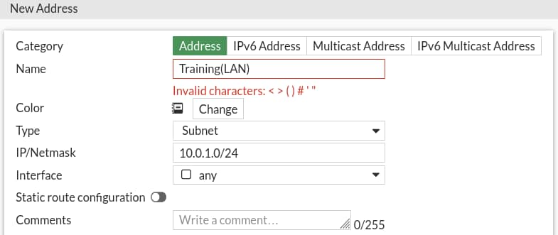
Naming Rules and Restrictions
Most firewall object name fields accept up to 35 characters
Supported characters in a firewall object name:
  Numbers: 0 to 9
  Letters: A to Z (uppercase and lower case)
  Special characters: hyphen - and underscore _
  Spaces
    Avoid using spaces in general
Some special characters are supported in passwords, comments, replacement messages, and so on
  < > ( ) # “ ” ‘ ’
Policy & Objects > Addresses
Notes:
When configuring names for firewall objects, only specific characters are supported. For example, Training(LAN) is not a valid name for an address object because it includes special characters that are not supported. Although spaces are supported in the names, as a best practice, avoid using spaces in names. Instead, use a hyphen or underscore. Using spaces can cause issues when trying to modify on the CLI, or troubleshooting.
However, many special characters are supported in passwords, comments, replacement messages, and so on.

Slide 40
Best Practices
Test policies in a maintenance window before deploying in production
  Test policy for a few IP addresses, users, and so on
Be careful when editing, disabling, or deleting firewall policies and objects
  Changes are saved and activated immediately
  Resets active sessions
Create firewall policies to match as specifically as possible
  Example: Restrict firewall policies based on source, destination, service
  Use proper subnetting for address objects
Analyze and enable appropriate settings on a per-policy basis
  Security profiles
  Logging settings
Notes:
Always plan a maintenance window and create a test case for a few IP addresses and users, before implementing configuration changes in the production network. Any configuration changes made using the GUI or CLI take effect immediately, and can interrupt service.
As a best practice, try to configure firewall policies as specifically as possible. This helps to restrict access to only those resources. For example, use correct subnets when configuring address objects.
Another setting worth mentioning is security profiles. Security profiles help to provide appropriate security for your network. Proper logging configuration can also help you to analyze, diagnose, and resolve common network issues.

Slide 41
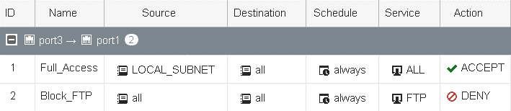
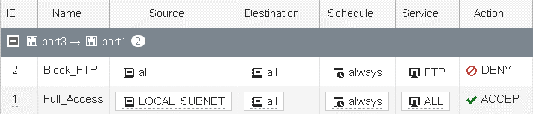
Adjusting Policy Order
On the GUI, drag-and-drop
Before policy move
After policy move
ID remains same
config firewall policy
edit 1
set name “Full_Access"
...
next
edit 2
set name "Block_FTP"
config firewall policy
edit 2
set name "Block_FTP"
...
next
edit 1
set name " Full_Access"
Notes:
Remember you learned that only the first matching policy applies? Arranging your policies in the correct position is important. It affects which traffic is blocked or allowed. In the section of the applicable interface pair, FortiGate looks for a matching policy, beginning at the top. So, you should put more specific policies at the top; otherwise, more general policies will match the traffic first, and more granular policies will never be applied.
In the example shown on this slide, you’re moving the Block_FTP policy (ID 2) that matches only FTP traffic, to a position above a more general Full_Access (accept everything from everywhere) policy. Otherwise, FortiGate would always apply the first matching policy in the applicable interface pairs—Full_Access–and never reach the Block_FTP policy.
When moving the policies across the policy list, policy IDs remain unchanged.
Note that FortiGate assigns the next highest available ID number as policies are created.
Note that policy IDs are identifiers and are not displayed by default on the policy list GUI. You can add a policy ID column using the Configure Table settings icon.

Slide 42
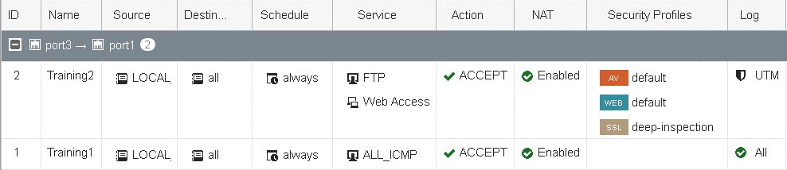
Combining Firewall Policies
Check the settings before combining firewall policies
  Source and destination interfaces
  Source and destination addresses
  Services
  Schedules
  Security profiles
  Logging
  NAT rules
Can combine Policy ID 1 and 2 by combining services
Make decisions for logging settings when combining Policy ID 1 and 2
Policy & Objects > Firewall Policy
Notes:
In order to optimize and consolidate firewall policies, always check all configured settings. In the example shown on this slide, the two firewall policies have differences in terms of services, security profiles, and logging settings. You can consolidate these two firewall policies by combining services and choosing appropriate logging settings.
If you select Security Events (UTM) for the logging settings, traffic logs will not be generated for ALL_ICMP traffic.
Note that the ALL_ICMP service is not subject to web filter and antivirus scans, which means that applying these security profiles to the ICMP traffic will result in the traffic passing through without being inspected.

Slide 43
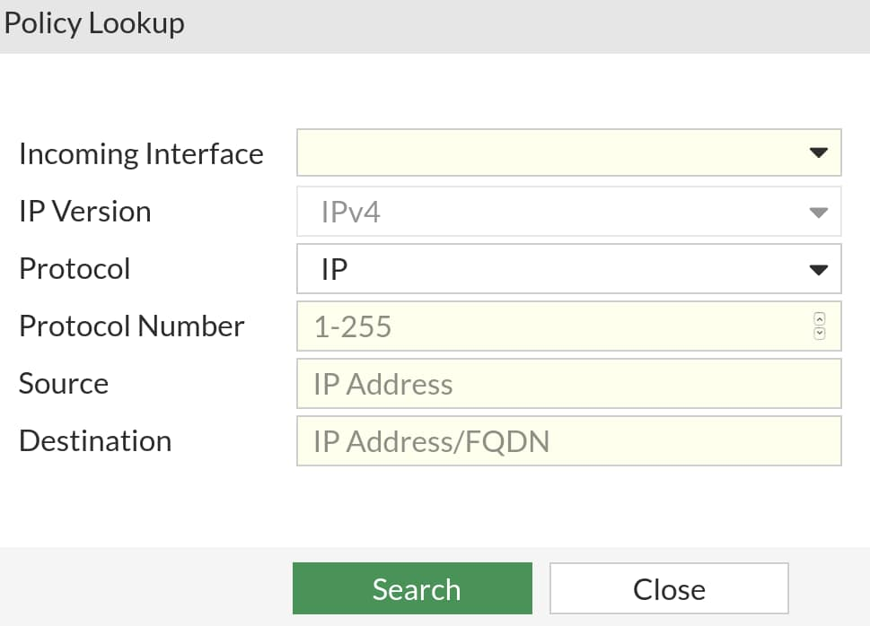
Policy Lookup (GUI)
Identify matching policy without real traffic
  Does not generate any packets
Searches matching policy based on input criteria
  Source interface
  Protocol
    Requires more granular input criteria
  Source IP address
  Destination IP/FQDN
Policy lookup checks
  Reverse path forward (RPF)
  Destination NAT, if matching virtual IP
  Route lookup, to resolve destination interface
Policy & Objects > Firewall Policy
Notes:
You can find a matching firewall policy based on the policy lookup input criteria. Policy lookup creates a packet flow over FortiGate without real traffic. From this, policy lookup can extract a policy ID from the flow trace and highlight it on the GUI policy configuration page.
Depending on the protocol you select (for example, TCP, UDP, IP, ICMP, and so on), you need to define other input criteria. For example, when you select TCP as the protocol, you need to define the source address, source port (optional), destination port, and destination address. When you select ICMP as the protocol, you need to define the ICMP type/code, source address, and destination address.
When FortiGate is performing policy lookup, it performs a series of checks on ingress, stateful inspection, and egress, for the matching firewall policy, from top to bottom, before providing results for the matching policy.
Note that if the firewall policy status is set to disable, the policy lookup skips the disabled policy and checks for the next matching policy in the list.
When FortiGate is in Transparent mode, it does not support the policy lookup function.

Slide 44
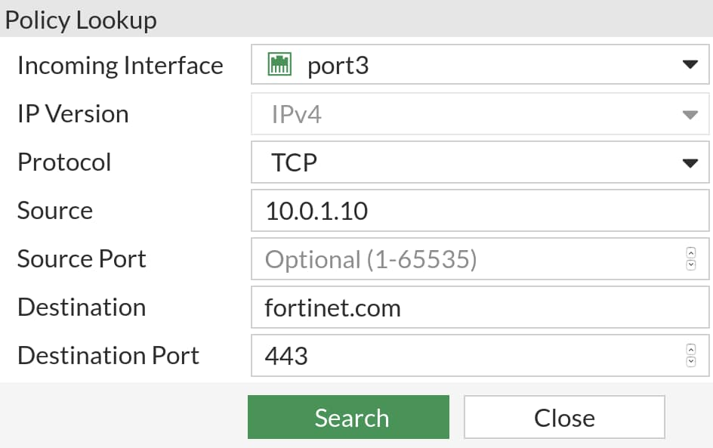


Policy Lookup Example (GUI)
Highlights matching policy after search
Policy & Objects > Firewall Policy
Notes:
Based on the input criteria, after clicking Search, the trace result is selected and highlighted on the Firewall Policy page.
Why didn’t policy ID #1 or ID #2 match the input criteria?
Because policy ID #1 status is set to disable, policy lookup skips the disabled policy. For firewall policy ID #2 , it doesn’t match the destination port specified in the policy lookup matching criteria.

Slide 45
Which of the following naming formats is correct when configuring a name for a firewall address object?
  Good_Training
  Good(Training)
What is the purpose of the policy lookup feature on FortiGate?
  To find a matching policy based on input criteria
  To block traffic based on input criteria

Slide 46
Firewall Policies
Configuring Firewall Policies
Managing Firewall Policies
Best Practices and Troubleshooting
Notes:
Congratulations! You have completed this lesson.
Now, you will review the objectives that you covered in the lesson.

Slide 47
Identify components of firewall policies
Identify how FortiGate matches traffic to firewall policies
Restrict access and make your network more secure using security profiles
Configure logging
Identify policy list views
Understand the use of policy IDs
Identify where an object is referenced
Identify naming restrictions for firewall policies and objects
Reorder firewall policies for correct matching
Demonstrate how to find matching policies for traffic type
Notes:
This slide shows the objectives that you covered in this lesson.
By mastering the objectives covered in this lesson, you learned how to configure, use, and manage firewall policies.

